Slide 1
E
B
2
3
α₂
C
ω₂
4
1
A
D

Slide 2
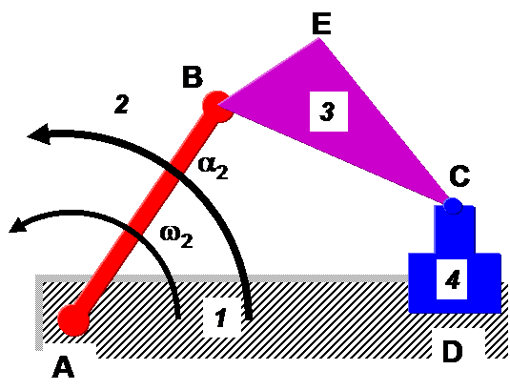
V_{B2} = ω₂XAB
V_{B3} = V_{B2}
V_{C3} = V_{B3} + V_{C3B3}
V_{C3} = V_{C4} = V_{D4}
V_{C3B3} = ω₃XCB
V_{E3B2} = ω₃XEB
V_{E3C4} = -ω₃XEC
V_{E3} = V_{B2} + V_{C3B2}
= V_{C4} + V_{C3D4}
B₃, B₂
V_{C3B3} = ω₃XCB
V_{B2} = ω₂XAB
E₃
V_{E3}
C₃, C₄ , D₄
O_{V}
V_{C4}
Velocity vector lines are perpendicular or parallel to lines, indicating the displacement vectors, appearing on the mechanism. Diagram is schematic, not to scale

Slide 3
a_{B2,n} = ω₂²AB
a_{B2t} = α₂AB
a_{B2,} = a_{B3} = a_{B2,n} + a_{B2,t}
a_{C4} = a_{C3}
= a_{B2n}+ a_{B2t}+ a_{C3B2 n}+ a_{C3B2t}
= a_{D4n}+a_{Dt}+ a_{C3D4n}+ a_{C3D4t}
a_{E3} = a_{B3}+ a_{E3B2 n}+ a_{E3B2t}
a_{C4t} = a_{D4t} = a_{c4,s} = a_{D4,s}
a_{C4n} = a_{D4n} = 0
Magnitudes and directions of all ω s are available from velocity diagram
C₃, C₄, D₄
a_{C4}
O_{a}
a_{B2}
a_{C3B2 t}
a_{C3B2 n}
a_{B2,n}
E₃
a_{E3}
B₃ , B₂
a_{E3,t}
a_{E3,n}
a_{B2,t}
====== normal component
_______ tangential component
Diagram is schematic, not to scale

